Slide 1
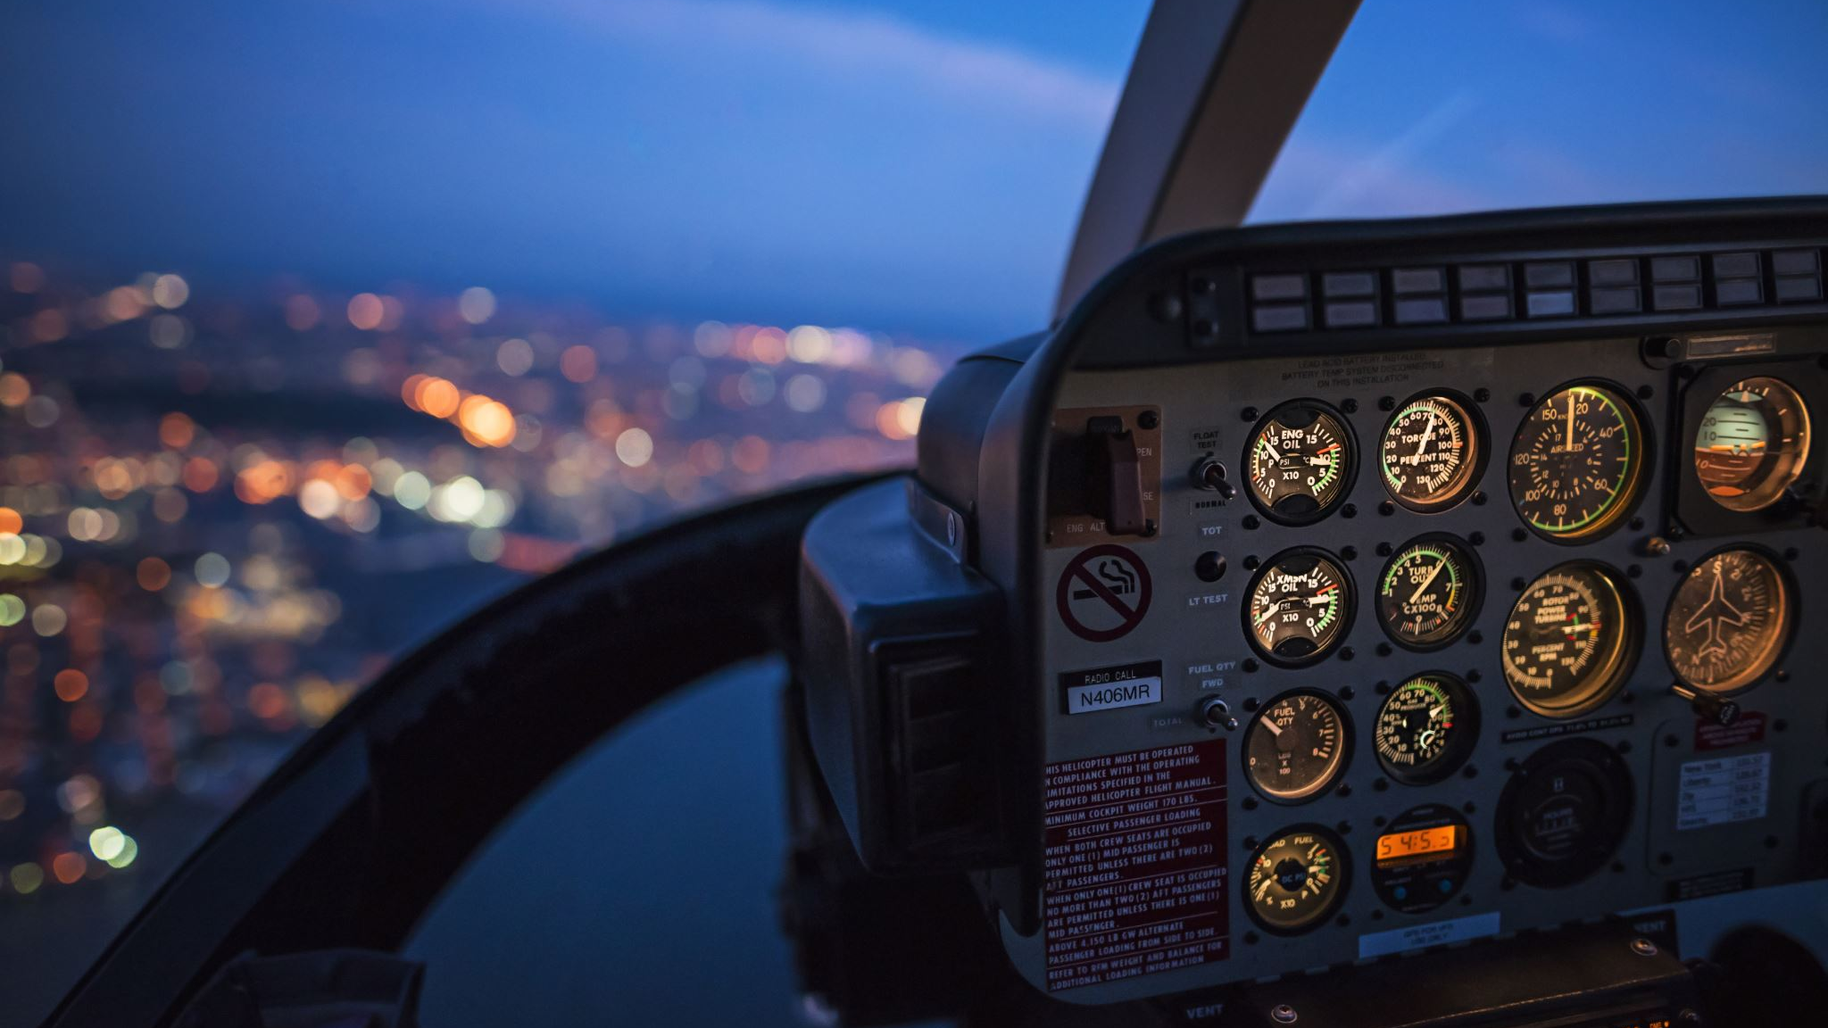


Cirium Hackathon 2023
Team AMCS
Vanshul Kumar, Joseph Barnett, Oliver Atkins

Slide 2

Code Presentation

Slide 3
The code's prime focus
To calculate the average time on ground for each airline with flights between (0,180) minutes.
Visualize the outcomes.
Provide Joe and Olly the outcomes from each airline.

Slide 4
Tools used
Used R Studio.
Libraries include:
Tidy verse
GGally
Readr
ISLR
Used Google chat and teams for file sharing and communication.
Maintained Logbook along with other teammates to keep track of the tasks. Link to the Log-book
Git hub for version control; Link to the repository
Lucid chart for flow-charts.

Slide 5
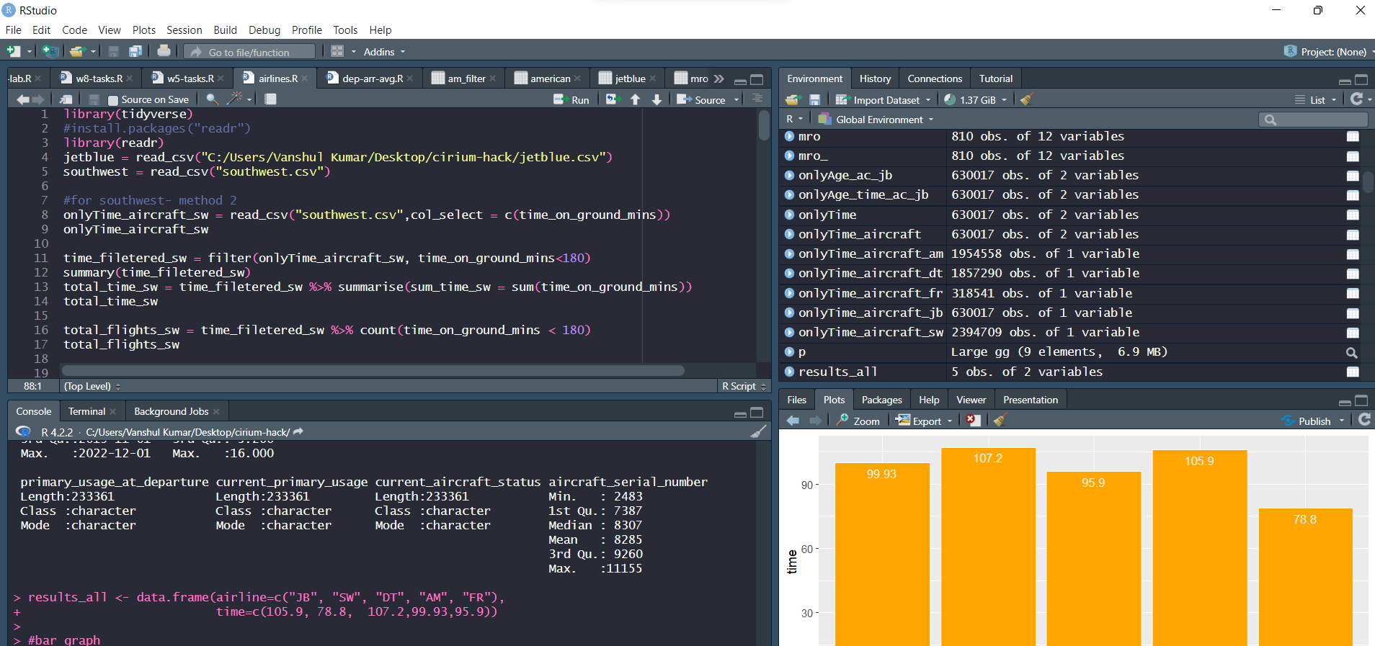
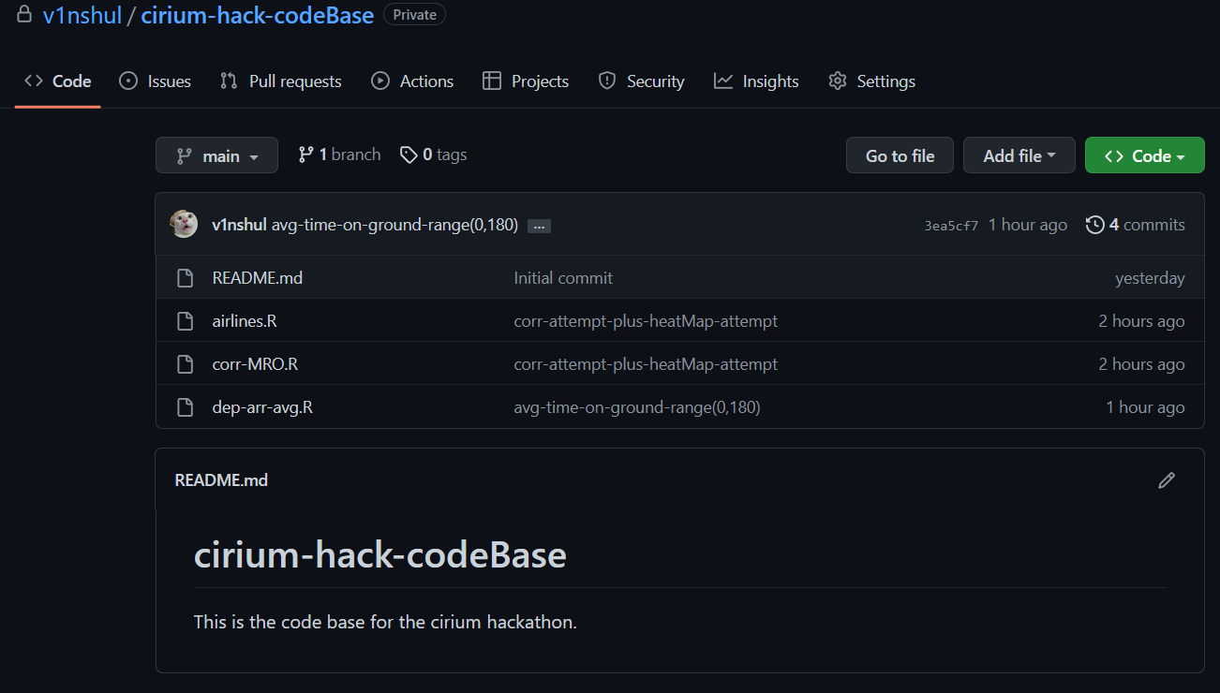
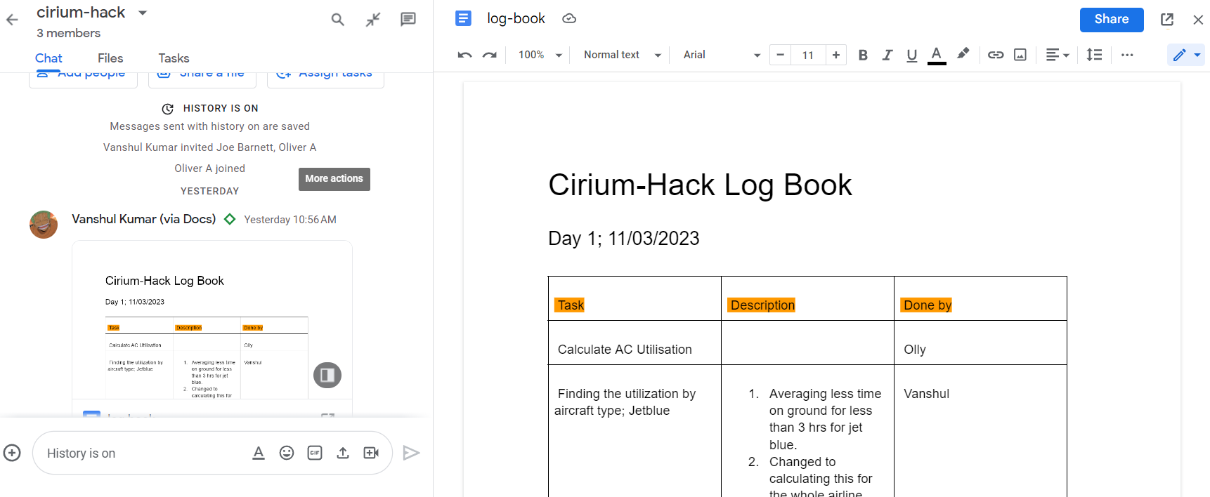

Slide 6
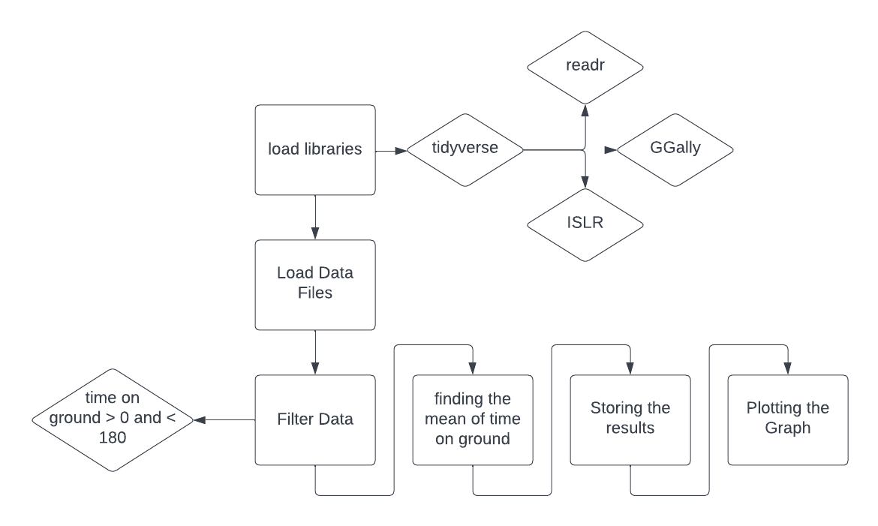
Code Flow

Slide 7
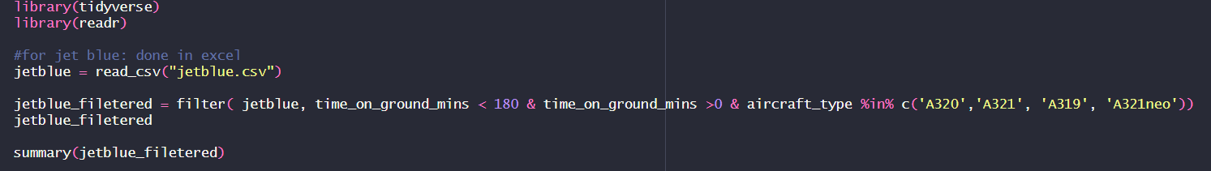
Functioning of the Code-1
In the above code we see that:
The libraries being loaded.
The data provided being loaded.
Filtering taking place.
Getting the mean through the summary function.
We carry out this method repeatedly for each airline, record the findings, and then display a graph to show it.

Slide 8
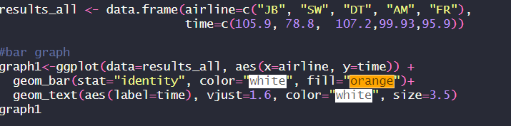
Functioning of the Code-2
In the code above we can see that the results are stores in a new data frame.
Then the function "geom_bar" turns the data frame into a bar graph.
The "geom_text" function allows us to put results on the graph for better readability.

Slide 9
If we had more time...
Discovering the Relationship Between Time on Ground and Aircraft Age.
Make a subset of the whole data and then process it.
Try to find any possible correlation for the subset.
Finding Correlation between features in MRO.
I made an effort to code the correlation, but because it wasn't the main goal, the task was shelved. The code for the correlation that I try to find is available in the repository. I also attempted to create a heatmap, but the amount of data prevented me.:
Using subsets for the filtered data is therefore one potential option.

Slide 10
Airline Business Models
Low-Cost Carrier (LCC)
Southwest
Frontier Airlines
Hybrid
JetBlue
Full-Service Carrier (FSC)
American Airlines
Delta Airlines

Slide 11
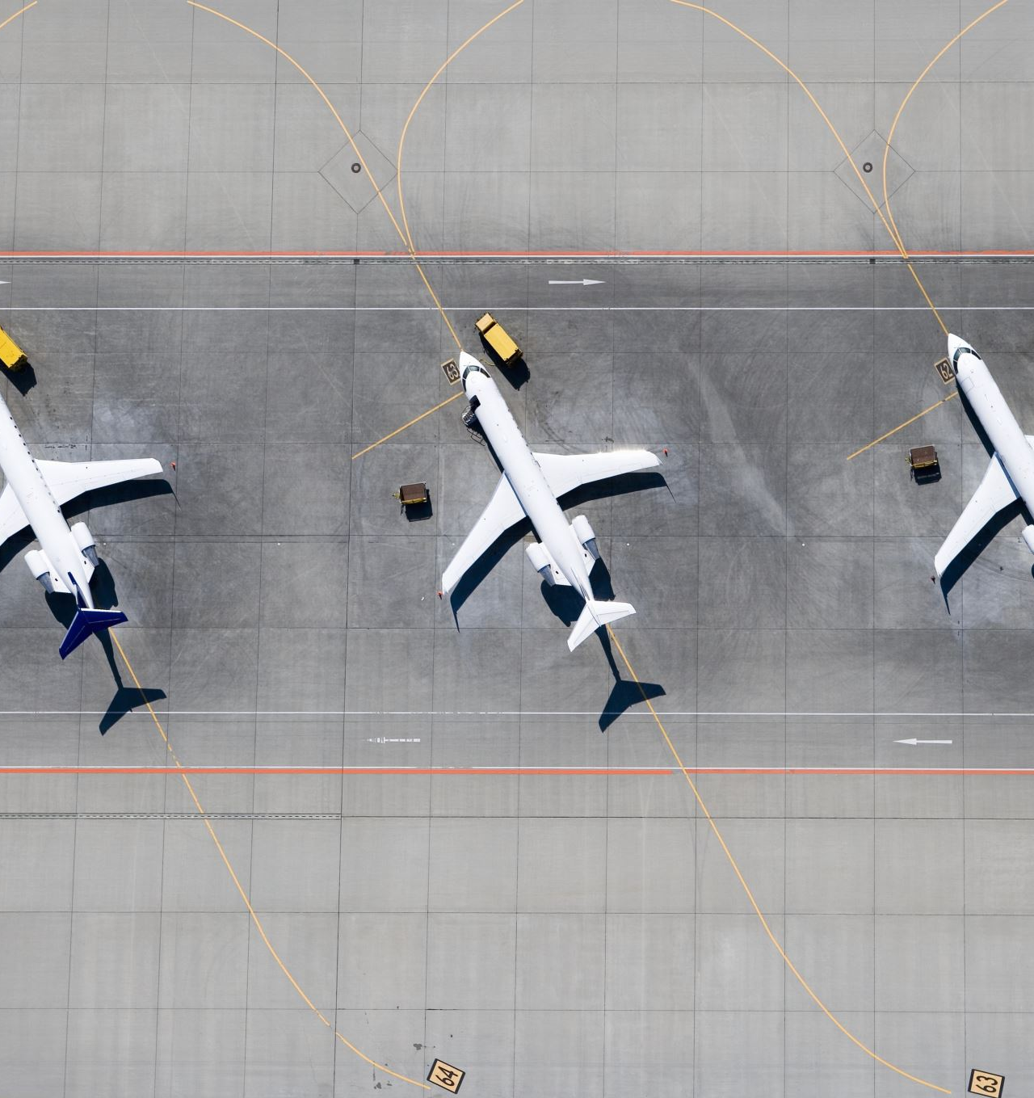
Aircraft Utilisation

Slide 12
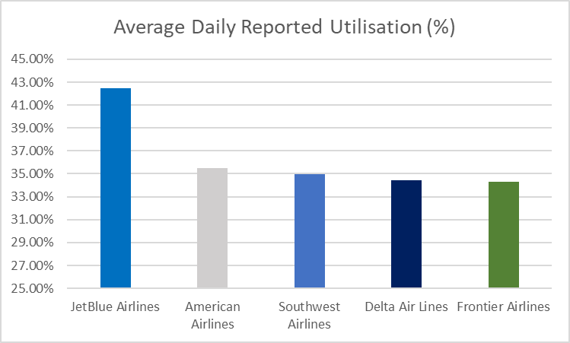
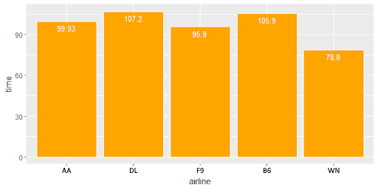
Several factors effect utilisation
JetBlue and Southwest stand out
Schedule optimisation and faster turnaround times improve utilisation
Notes:
Several factors that effect aircraft utilisation - turnarounds, schedules and business model, which are addressed in greater detail in the following slides.
The graph simply illustrates the average daily reported utilisation of each airline as a percentage of a 24 hour period – the most interesting points we picked up here were JetBlue and Southwest. Firstly, Southwest who we expected to be the leader here lie behind JetBlue and American which is associated with the high number of sectors their aircraft will fly, reducing utilisation.
JetBlue are also interesting being a hybrid carrier, its positive to see their utilisation so high, it needs to be due to the fact they offer premium products at a price that undercuts legacy carriers such as American and Delta.
Now, there are 2 main ways you can optimise utilisation – schedule optimisation and faster turn times, and these will be discussed in the upcoming slides.

Slide 13
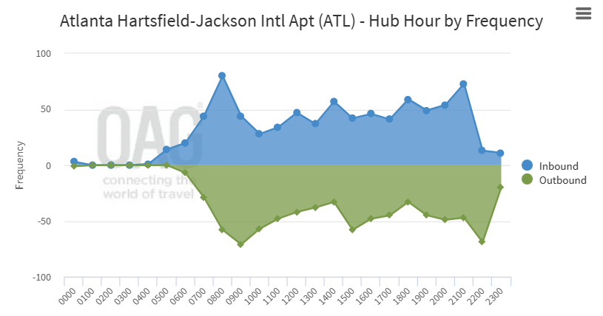
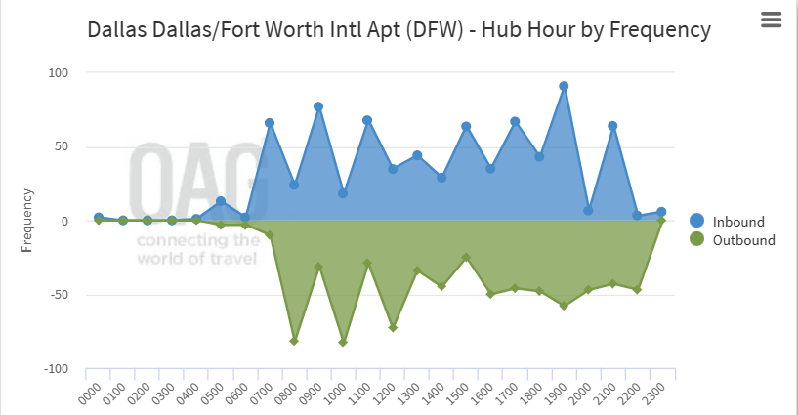
Utilisation and Business Model
Higher turnaround time is linked to airline strategy
Time banks at hub airports facilitate critical feeder traffic
e.g., AA at Dallas Fort Worth International (DFW) and DL at Atlanta Hartfield Jackson International (ATL)
LCCs following P2P minimises aircraft ground time
Notes:
From the previous slide, the traditional legacy carriers, American Airlines and Delta, have higher average turnaround times. At face value, this shows operational inefficiencies – especially as minor reductions in turnaround time can convert to significant gains in utilisation terms. Boeing state reducing turn-time by 10 minutes on a trip of 500 nautical miles, improves utilisation by 8% and its small alterations like this that low-cost carriers such as Southwest, have built positive reputations around – hence the considerably lower average turnarounds.
However, full-service carriers like American and Delta will typically operate at their hubs around strategic time banks (high traffic activity period) in order to facilitate connecting traffic from feeder to trunk routes, which are generally seen as the most lucrative – allowing their passengers to fly inbound on domestic flights and then depart on long-haul, international routes. (Briefly explain figures – 10th of March '23)
And so, although losing out in terms of efficiency, longer turnarounds for FSCs maximises the window for revenue-generating passenger connections and these carriers view this as a worthwhile tradeoff when compared to their low-cost competitors.

Slide 14

Schedule Optimisation (LCC)
"Clean Sheet Optimisation"
An innovative approach giving greater schedule flexibility
Driving towards greater yields

Slide 15
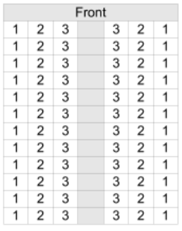
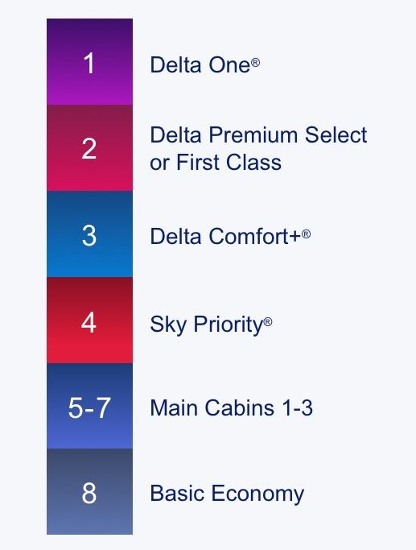
Reducing Turnaround - Delta
Boarding/Deboarding is the most time-consuming activity in an aircraft turnaround
Boarding by priority then fare class
Improves passenger satisfaction, with passengers paying more for economy fares feeling like they are getting value
Poor for inefficiency
WILMA method
Boards passengers from window to aisle rather than traditional blocks or random boarding
Yields boarding time decrease of >10% (Steffen & Hotchkiss, 2012)
Notes:
So focusing on the airline which we found to have the highest average turnaround time for the short-haul fleet, how can Delta reduce turnaround time?
The most time consuming activity during an aircraft turnaround is deboarding and boarding, therefore this seems a logical area to focus on.
Currently, once the priority passengers have boarded, Delta organise boarding in the economy cabin by fare class. While this is good for passenger satisfaction, in terms of efficiency there is significant room for improvement.
Our recommendation to improve in this area is by using the WILMA method. There has been a wide range of studies into boarding methods, however the WILMA method provides a simple and easy to implement solution. Rather than boarding randomly or by traditional blocks, the WILMA method boards passengers by column essentially, from window to aisle. The increased efficiency of this method has been found to reduce boarding time by more than 10%.

Slide 16
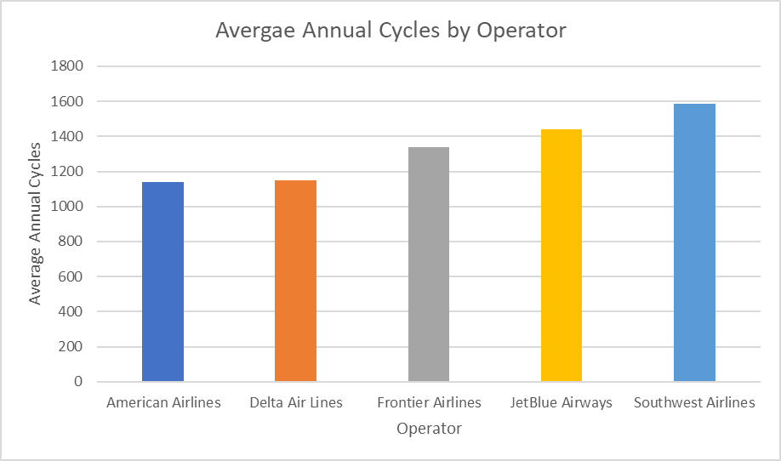
Operational Cycles
Low-cost carriers operate greater number of annual cycles
Indicative of the point-to-point operation
Increased maintenance needs with greater number of cycles
Link between WN's annual cycles and annual ground days
Notes:
Moving on to look at the effect of operational cycles, we see that American Airlines and Delta, as full-service carriers have lower annual cycles across their fleet which is expected with the long-haul routes they operate for example.
An interesting link is that Southwest conversely operate the highest average annual cycles at … and also, as previously mentioned by Olly, have the highest number of days lost to ground events. Reasons why this correlation is seen are that, with a greater number of cycles, this puts greater hoop stress on aircraft for example and thus will subject Southwest's fleet to greater maintenance needs.
This is combatted somewhat though by features such as Southwest's homogenised fleet and that 78% of their maintenance bases are positioned on their route network.

Slide 17
Ground Events

Slide 18
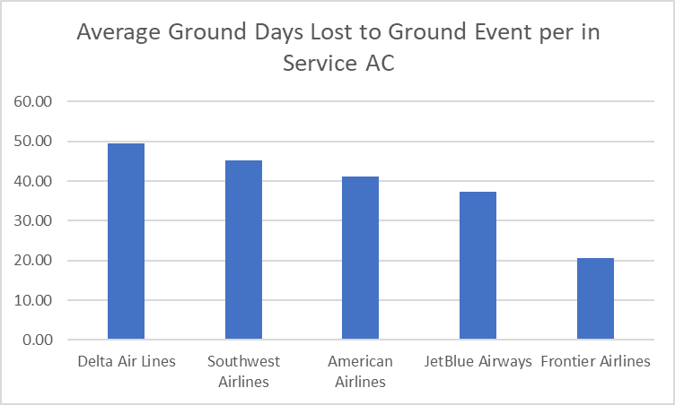
Mean Fleet Age | 15.1 | 12.5 | 12.6 | 12.4 | 4.3
Notes:
While airlines aim to minimise ground time, maintenance is an activity which must be considered. Figure X shows the average number of days lost to ground events per aircraft across the five airlines. This metric is more useful than analysing the total days lost because it takes into account fleet size. As you can see, Delta loses the most days to ground events, while Frontier perform significantly better than the other airlines.
This pattern becomes particularly telling when introducing the mean fleet age. As you can see, the mean fleet age is very strongly correlated to days lost to maintenance, with older fleets requiring more maintenance. An aspect of this can be attributed to maintenance cycles, with D checks needing to be completed

Slide 19
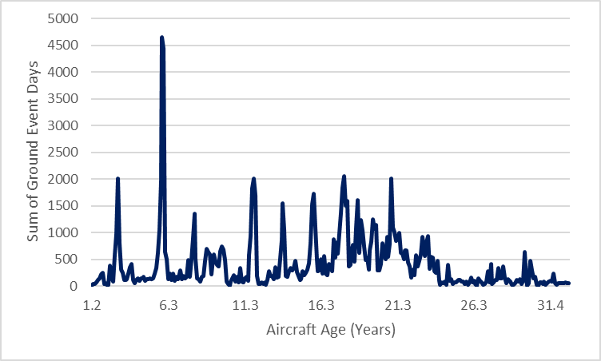
Why is Frontier losing so little to Maintenance?
Average fleet age of 4.3 Years
Average D-Check interval for A320 ~6 Years
D-Checks can take 3-6 weeks therefore fleet planning is essential (Garbuno, 2020)
Staggered Maintenance to minimise impact on operations
Notes:
So on the surface, it seems Frontier's maintenance operations are far more efficient than those of the other 4 airlines. But looking at maintenance cycles provides a more realistic representation of the reality. The average fleet age of Frontier is 4.3 years. Based on an average utilisation of 4 sectors per day, this means a D-Check will be required after approximately six years of the aircraft entering service. Again, this assumption can be backed up by the maintenance data provided, with Figure X showing a significant spike in ground event days when aircraft reach 6 years of age.

Slide 20
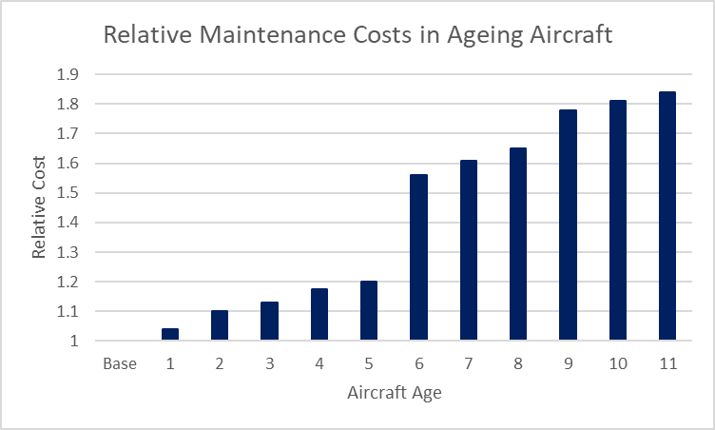
Fleet Renewal?
Young Aircraft = Lower Maintenance Costs in the short-term
Beneficial for a short-term cost reduction strategy
However, fleet renewal is extremely costly and requires several considerations:
Current fleet
Long/Short-term strategies
Financial Position
Route Network
Business Model
Age in Years | Phase
0-6 | Newness
7-12 | Maturity
12+ | Ageing
Notes:
So based on that logic, is fleet renewal a sensible strategy to minimise maintenance costs? Well, as is so often the case, it depends.
On one hand, younger aircraft typically require less maintenance, especially early in their life. Bechai presents a model which divides an aircraft's life into three phases, newness, maturity and aging. As we can see from figure X, maintenance costs are significantly reduced in the newness phase. Therefore, if an airline were to prioritise short term cost reduction, this would prove beneficial.
However, deciding on a strategy of fleet renewal is not a simple decision. Unfortunately, we haven't had the time to conduct an in-depth analysis as to whether this is a feasible option for the airlines in the case study, however things to consider would include: Current fleet, long and short term strategies, financial position, route network and business model and maintenance

Slide 21
Maintenance Locations
Airline | MX Bases | Percentage of MX on Route Network | AC Types in Fleet
WN | 9 | 77.8% | 1
F9 | 3 | 66.7% | 1
AA | 16 | 62.5% | 4
DL | 21 | 38.1% | 8
B6 | 7 | 14.3% | 3
High percentage on maintenance bases on route network decreases unnecessary flying
Airlines with high fleet commonality consolidate maintenance to fewer bases
Increased bargaining power
Increased flexibility
Notes:
When we're considering maintenance facilities, obviously it is in an airline's best interest from both a financial and environmental perspective to conduct maintenance as close to their route network as possible. Figure X there presents a summary of the percentage of each airline's maintenance activities that take place at airports on their route network.

Slide 22
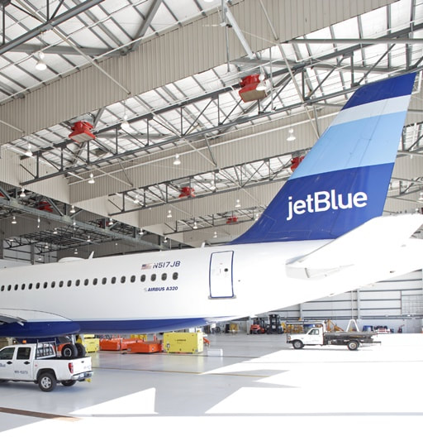
JetBlue Maintenance – JFK?
Light/Line Maintenance base at JFK
Upgrading this to heavy maintenance would bring benefits
Operational flexibility
However, JFK real estate expensive and congested so not feasible
Currently, their biggest heavy maintenance base is SAL
Cost savings
Operational disruption
However, heavy maintenance is rare

Slide 23
References
Bechai, D. (2017). The Importance Of Maintaining A Young Fleet. Seeking Alpha. https://seekingalpha.com/article/4049812-importance-of-maintaining-young-fleet
Cirium. (2023). Fleet Analyser. https://dashboard.cirium.com/app/fleet/#/analyser/aircraft
Garbuno, D. (2020). From A to D – How Aircraft Maintenance Checks Differ. Simple Flying. https://simpleflying.com/aircraft-maintenance-checks/
Steffen, J., & Hotchkiss, J. (2012). Experimental test of airplane boarding methods. Journal of Air Transport Management, 18(1), 64-67. https://doi.org/10.1016/j.jairtraman.2011.10.003

